Slide 1

Lance Townsend, Carla Kolze,
Carson Gustavel, Amanda Board, Patrick Du,
Owen McDaniel, Emily Smith

Slide 2
Doki Doki Library Club: Revolutionary Dating Sim
You are stuck in a library with Sonic, Charlie Brown, and Scooby Doo characters
There is only one way out of this nightmarish library: Dating
You must successfully woo one of the various characters in the game to leave
If you are unsuccessful in your advances on ALL characters, you are stuck there forever and lose
Dating involves talking to the characters and playing different mini games
Library is located in Miami, FL.
Lance

Slide 3
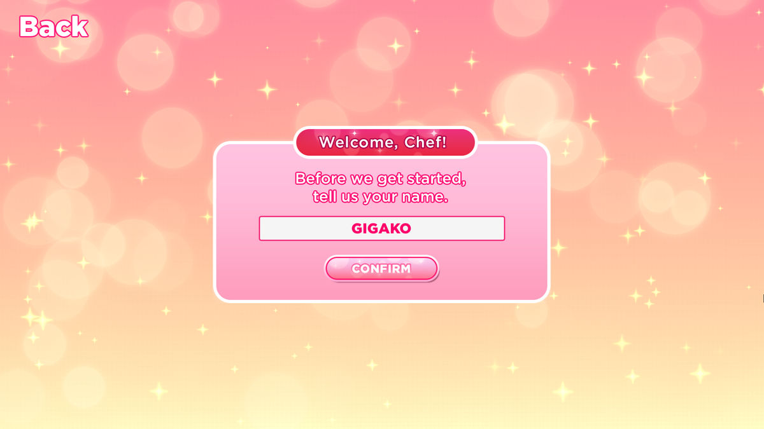
Story Board
Player enters game and gets a start menu. Player can enter their username that LI's will address them by.
The start menu will also give a brief overview of the game.
Penguine
Carla

Slide 4

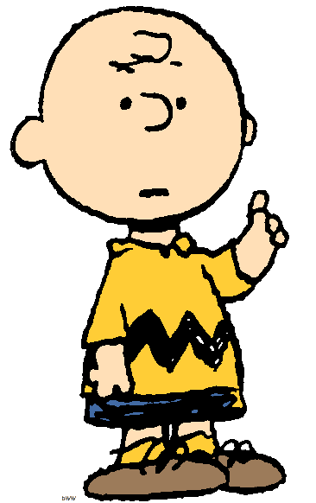

Story Board
Player enters the library and can choose who they talk to. In this example, player chooses to talk to Sonic.
Talk To Charlie
Talk To Sonic
Carla

Slide 5


Story Board
Ah yeah! This is happening!
Player talks to Sonic LI.
They have the option of at least to dialogues to respond with. Depending on their response, Sonic's affection points might increase. If Sonic really likes the responses, he will ask to go on a minigame date.
Oh no..
Oh yeah!!
Carla

Slide 6
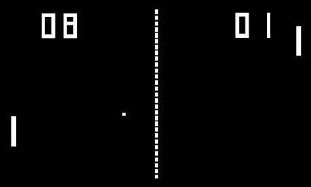
Story Board
Player is on a minigame date with Sonic. They play a short game (pong in this case) with Sonic (AI).
Certain LI's will like winning or losing the games. Sonic likes to win.
Carla

Slide 7

Story Board
Wow! I can’t believe I lost. :(
You won the game, and hence lost some of Sonic's affection points.
Now you will reenter the opening library shot and choose who to talk to next.
Carla

Slide 8

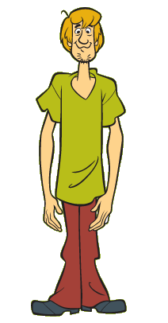
Story Board
Player pulls up the HUD menu to see all the other LI affection levels for them.
In this case, Sonic has been unenchanted enough by the player that the player has no chance with him, so he is greyed out.
Note: Some characters already have affection points for the player without meeting them, some don't.
AFFECTION LEVELS
Charlie Brown: 10
Sonic: 45
Shaggy: 0
Carla

Slide 9

Story Board
Player is in the library again and can choose who to talk to next. Say player chooses Charlie Brown.
Notes: Sonic is greyed out because player has disappointed him and exhausted any further romantic chances.
Talk To Charlie
Talk To Sonic
Carla

Slide 10
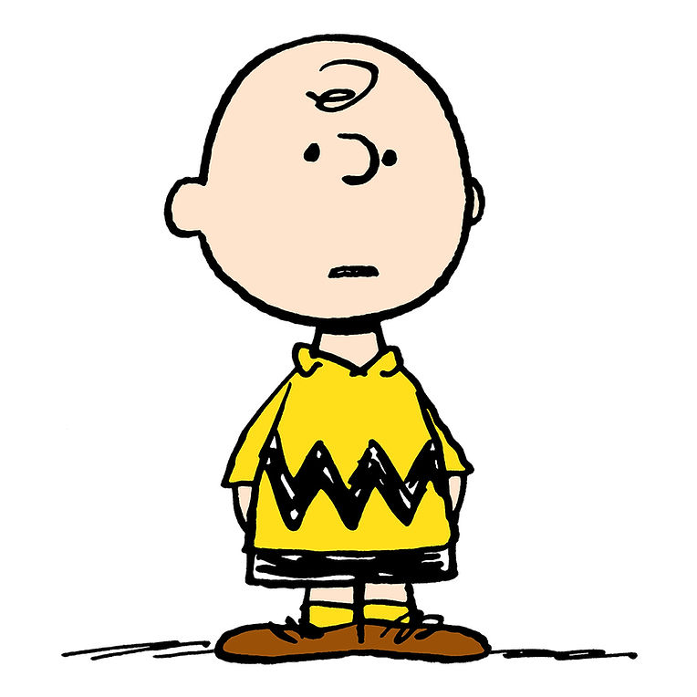
Story Board
Good grief. Don't you know you can't talk in a library?
Player is talking to Charlie Brown, who has his own dialogue, with different dialogue response options. Similar to Sonic, his affection levels and further dialogue will depend on which responses the player chooses.
Sorry Charlie! I just wanted to talk to you :)
Don't be a downer, Charlie Brown
Carla

Slide 11
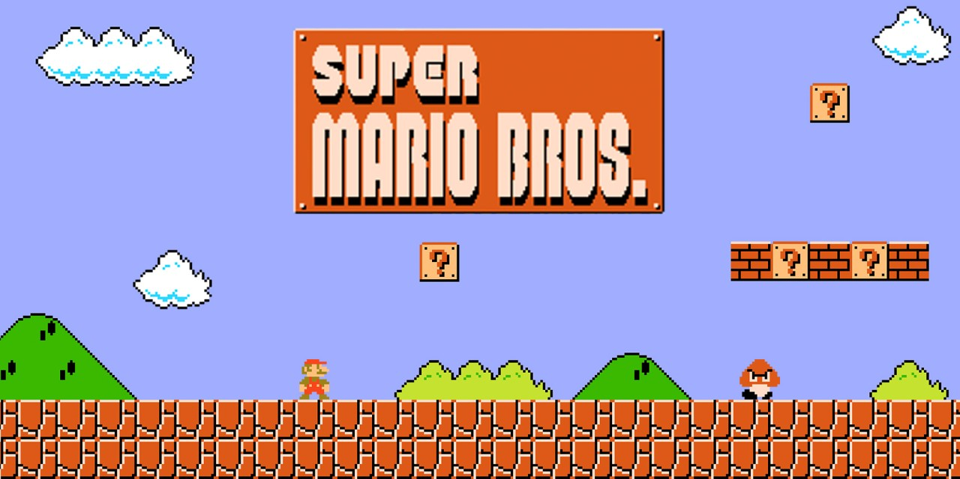
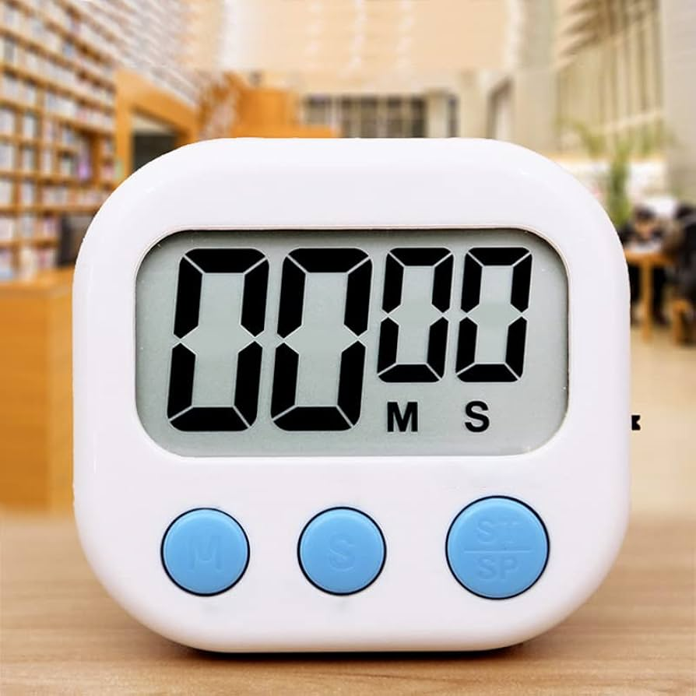
Story Board
Player is on a minigame with Charlie Brown because he likes you. In this game, he is not playing against you, but watching you play a timed game. His affection levels are dependent on if you win in time. You won't know his response until the game is over.
Carla

Slide 12
Story Board
Wow, you're worse than me! I sure like playing an equal.
You lost the game, and Charlie Brown liked that. His affection levels go up.
Carla

Slide 13
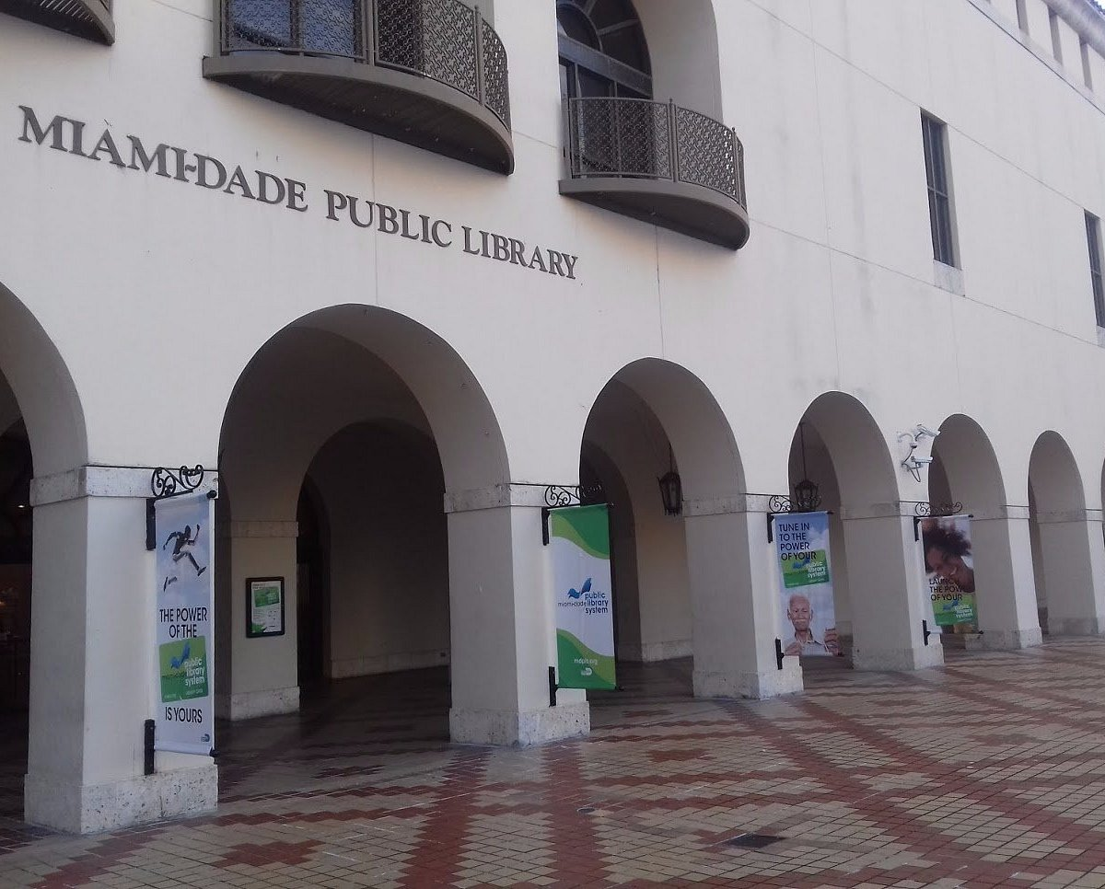
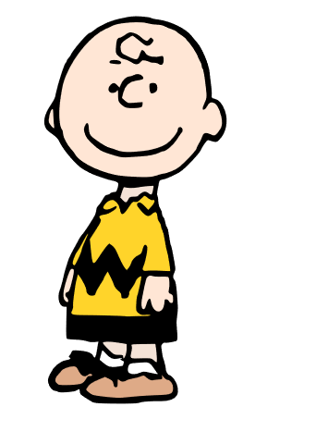

Story Board
Charlie Brown's affection levels for you are high enough that you have won his heart, and having found a partner to leave the Miami-Dade Public Library with, you won the game. The final screen is a cute heart with your chosen partner.
Penguine + Charlie Brown
forever
Carla

Slide 14

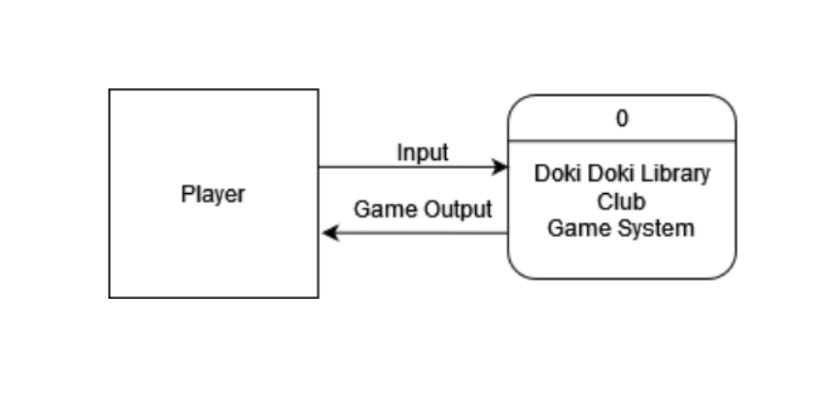
CONTEXT DIAGRAM SLIDE
Owen

Slide 15

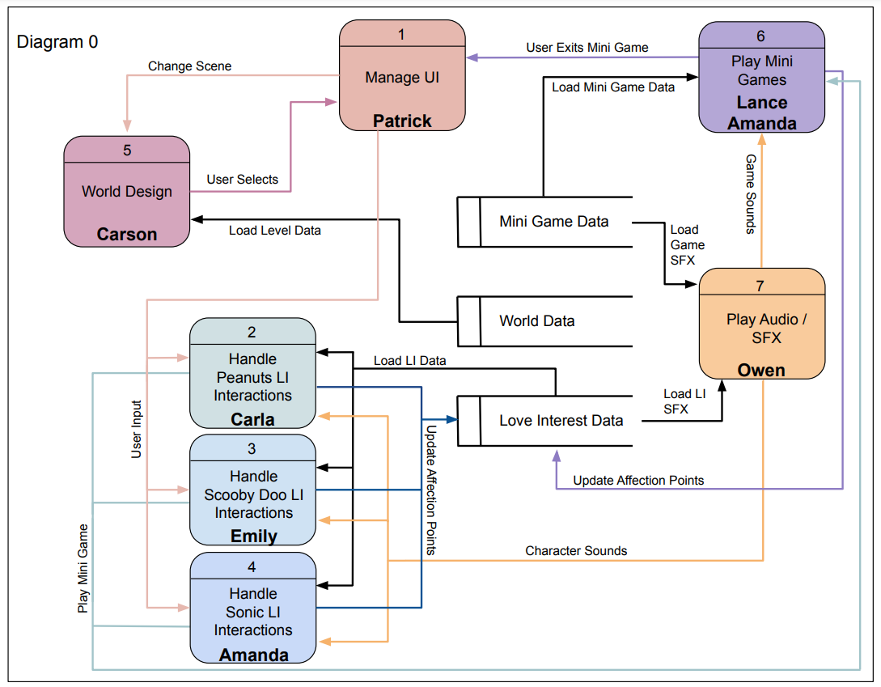
DIAGRAM 0
Carson

Slide 16
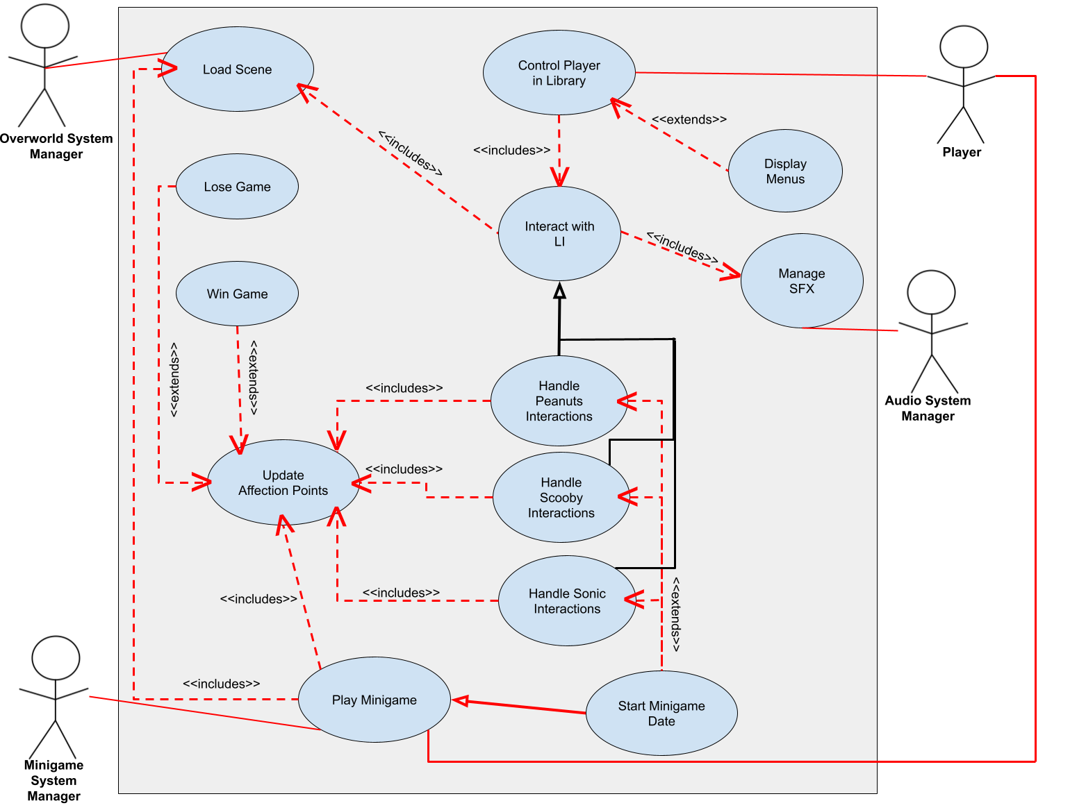
GLOBAL USE CASE
Patrick: Control Player – Show Overlay, Main Menu, Interact with LI
A/C/E: Handle Each LI Interaction
Owen: Audio/SFX
Owen: Player Gains Affection Points (eventually enough to initiate a date)
Lance: Start Minigame and Play
Owen: Player Gains Affection Points (updated)
Carson: Win/Lose the Game and Manage Overworld
Amanda

Slide 17
Process 1: UI Management
My feature: UI management
Room Movement
Love Interest Interaction
Main Menu
Show Overlay
Priority: 1
Room changes and character interaction input are essential to functionality of our game.
Relatively Low Complexity than other features
Patrick

Slide 18
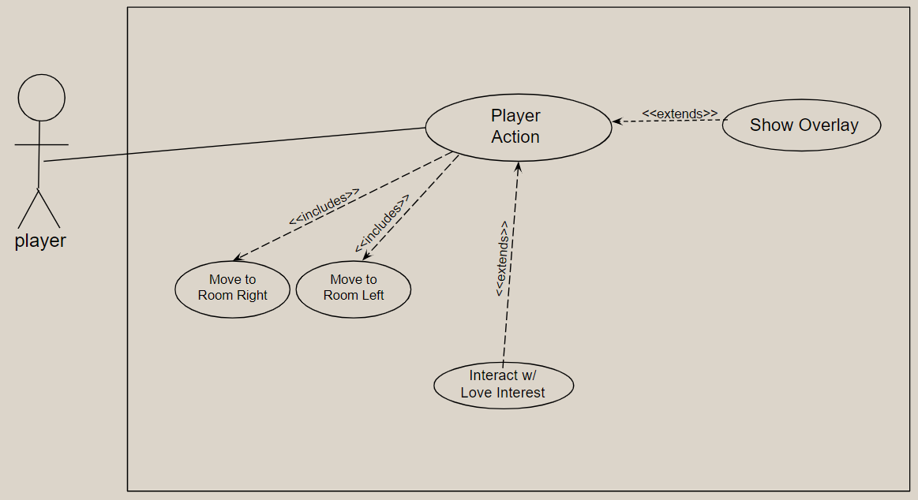
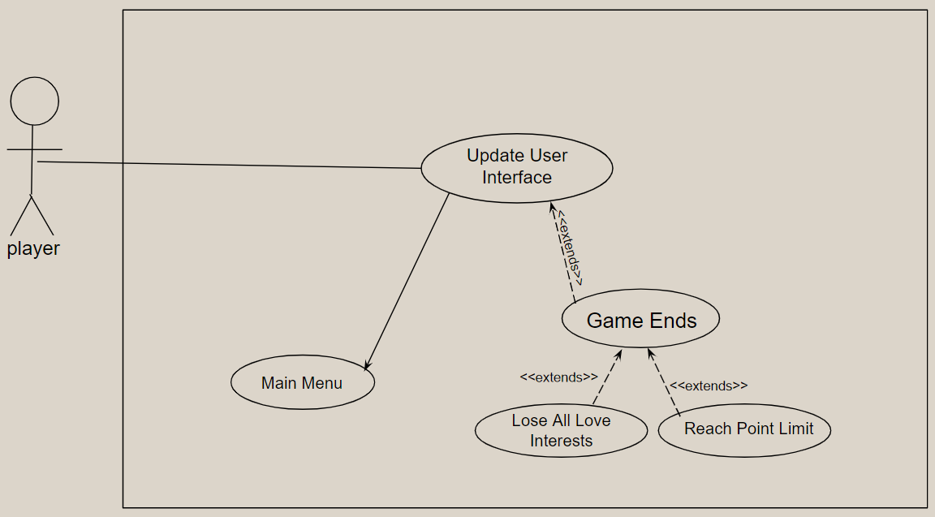
Use Case Diagrams: Process 1: UI Management
Patrick

Slide 19
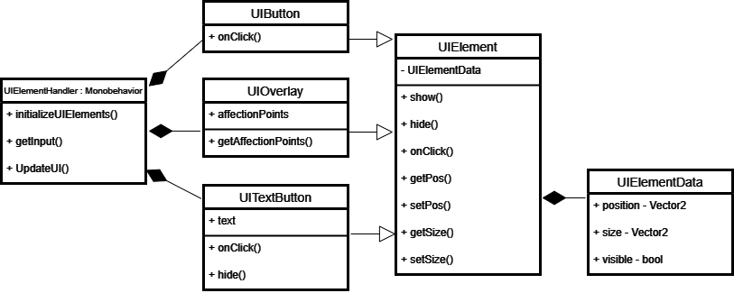
Class Diagram Process 1: UI Management
Patrick

Slide 20
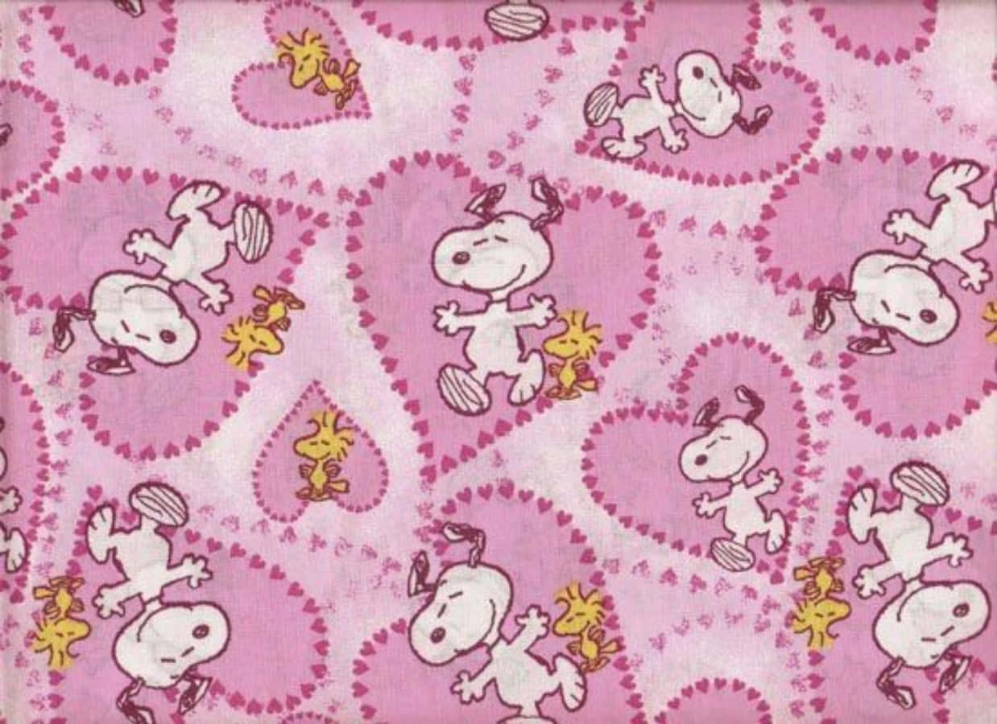
Process 2: Peanuts Characters LI Interactions
My feature: designing all Peanuts-inspired Love Interest characters
Includes:
Preferred dialogue answers unique to each character
A favorite minigame for each character
Visual character designs and representations
Priority: 1* (essential)
Complexity: Less Complex
Carla

Slide 21
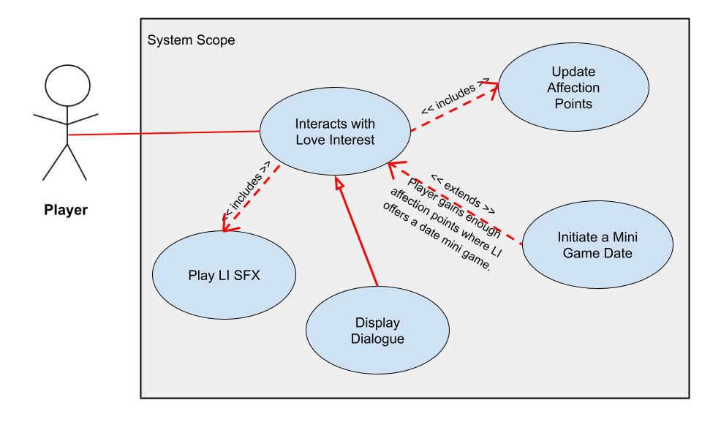
Peanuts LI Interactions
Use Case
Carla

Slide 22
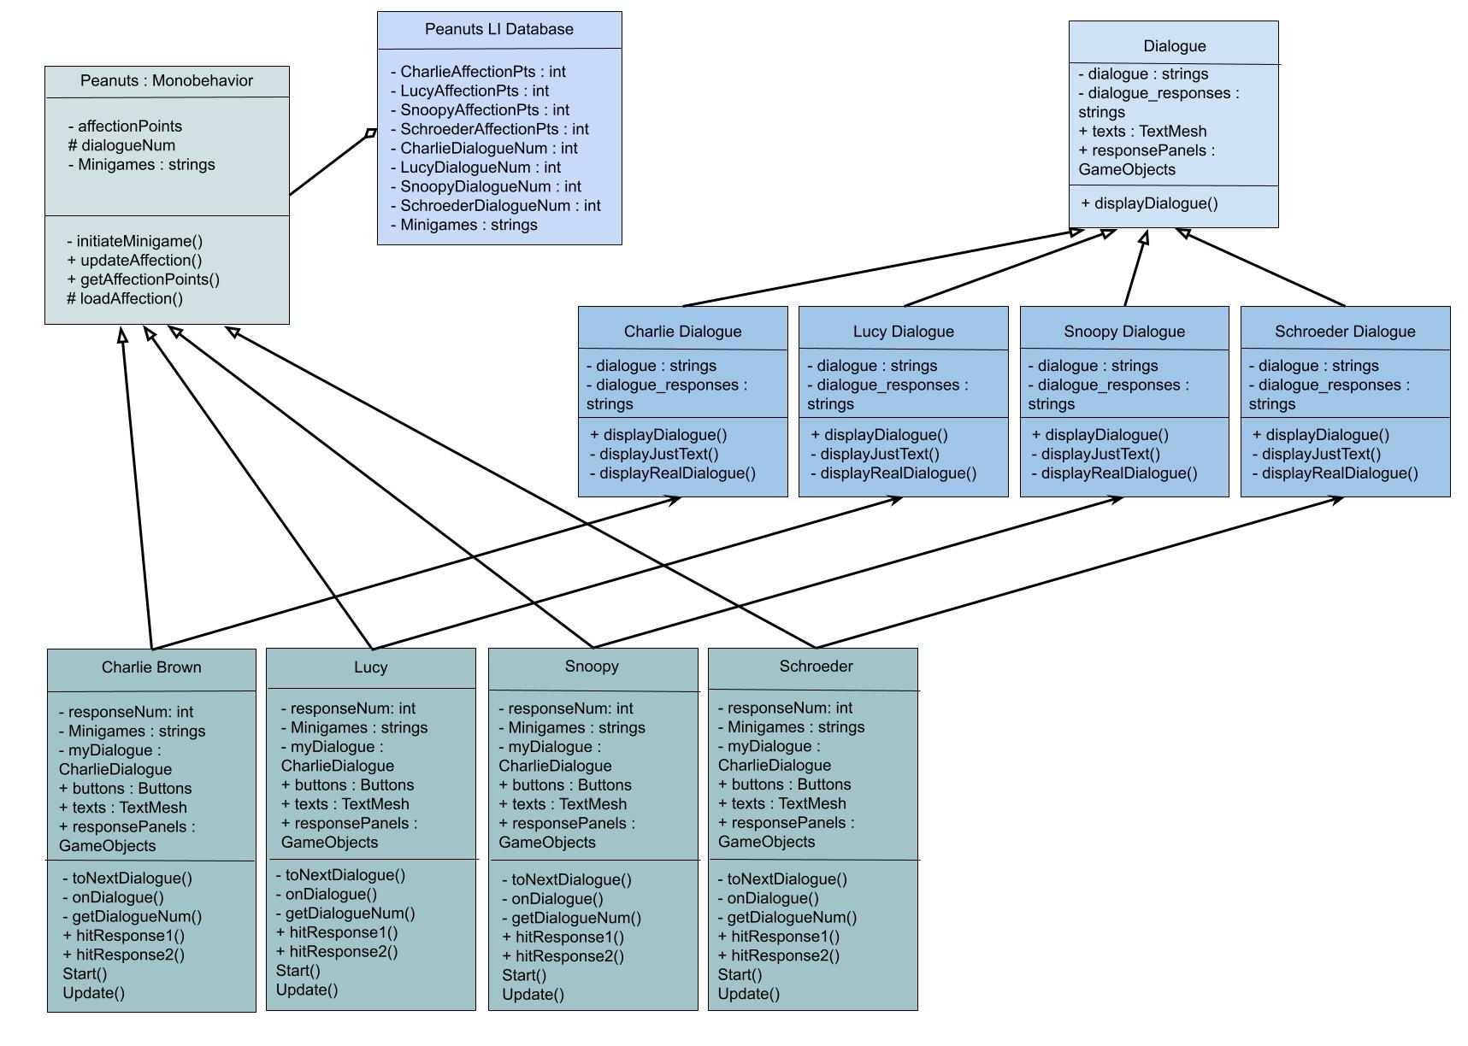
Peanuts LI Interactions
Class Diagram
Carla

Slide 23

Process 3: Scooby Doo LI Interactions
My feature: designing all Scooby Doo-inspired Love Interest characters
Includes:
Preferred dialogue answers unique to each character
A favorite minigame for each character
Visual character designs and representations
Complexity: Less Complex
Priority: 1* (essential)
Emily

Slide 24
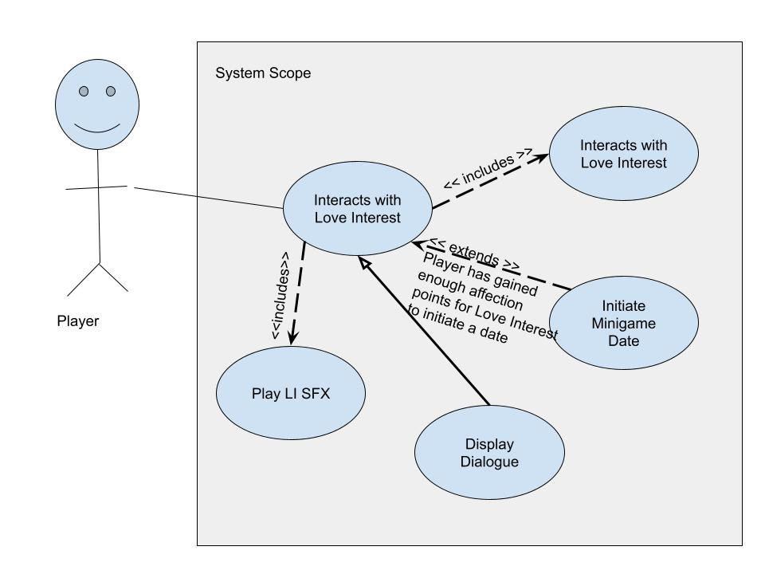
Scooby Doo LI Interactions
Use Case Explained:
Player initiates interaction with Love Interest
Plays SFX and displays dialogue and response options
LI can initiate a minigame date if they like the player
Results of likes/dislikes regarding dialogue responses and minigame are used to update affection points
Emily

Slide 25
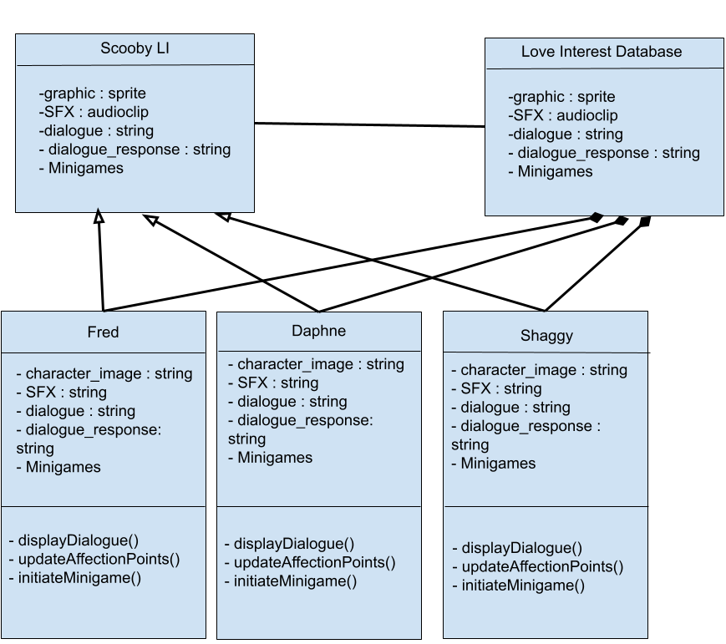
Scooby Doo LI Interactions
Class Diagram:
Superclass: Scooby LI
Subclasses: Fred, Daphne, Shaggy
Relation: Scooby LI and Dialogue Database
Composition: Dialogue Database and all subclasses
Emily

Slide 26
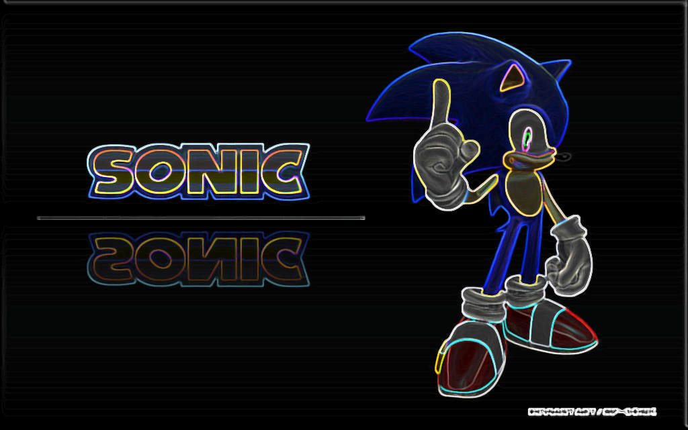
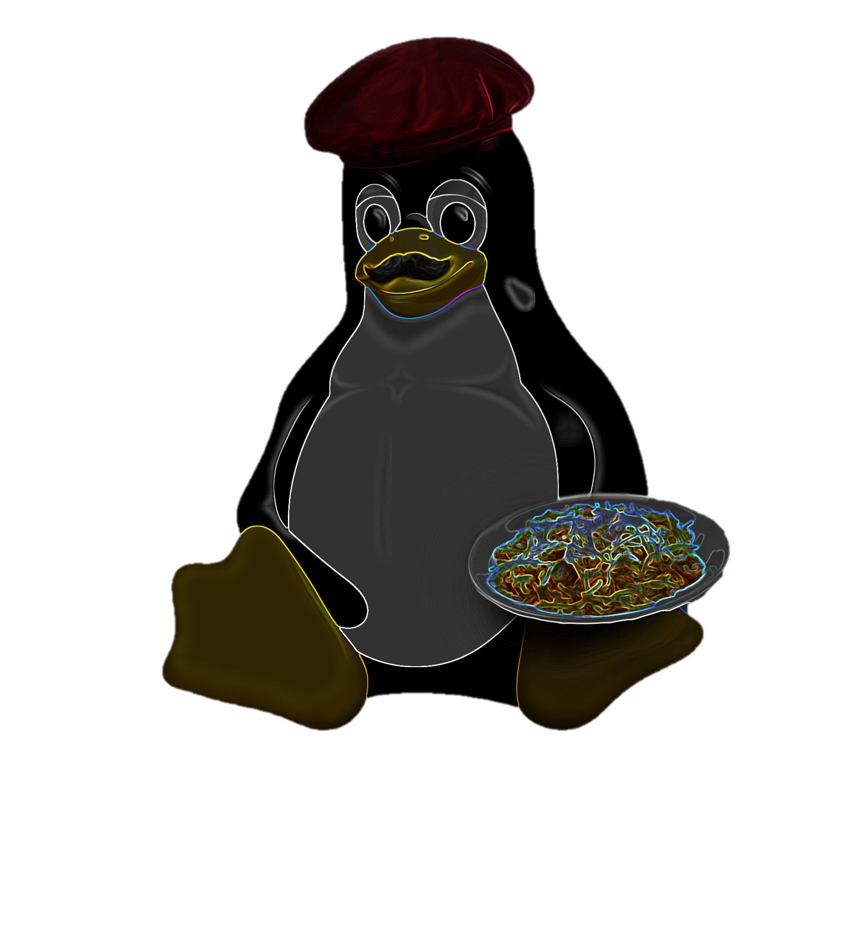
Process 4: Sonic LI Interactions
My feature: developing all Sonic-themed Love Interests (LI)
Includes:
Creating a script for main player and LI conversations
Preferred dialogue answers for each LI
A favorite minigame for each LI
Visual representations for each LI
Priority: 1* (essential)
Amanda

Slide 27
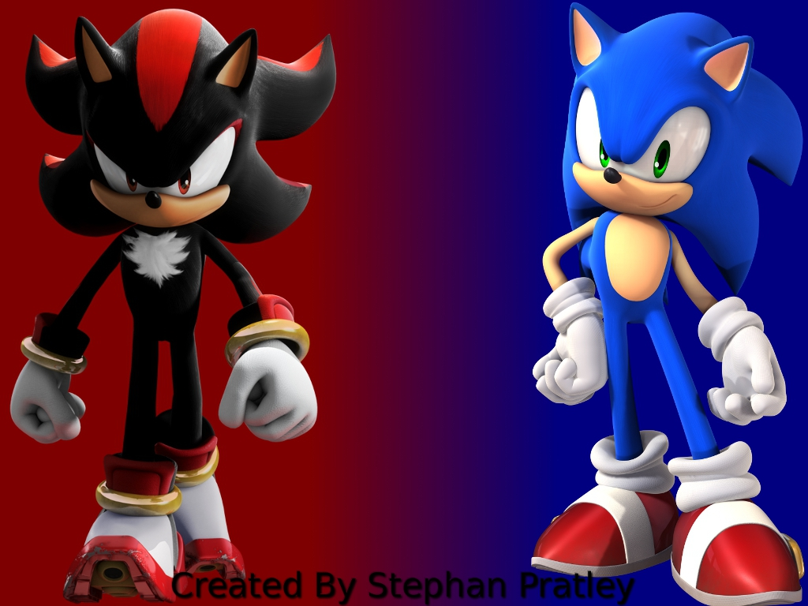
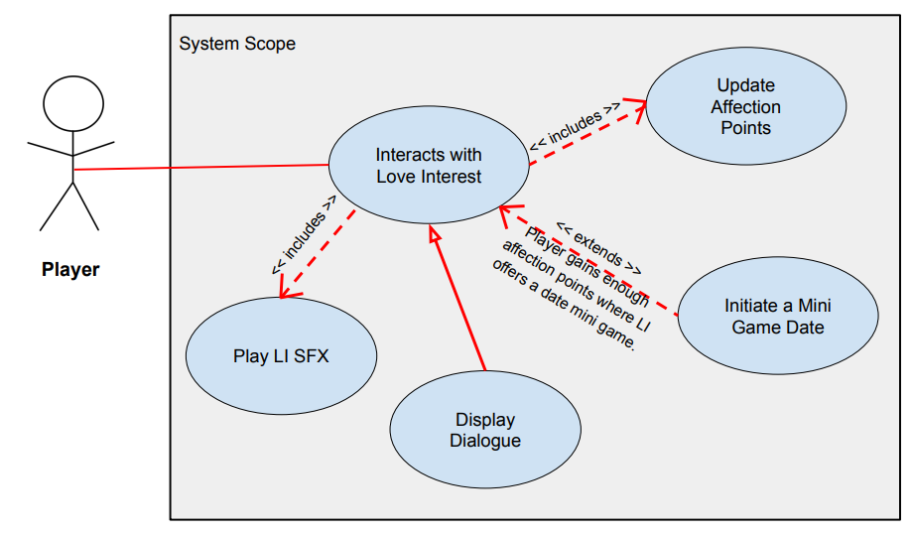
Sonic LI Interactions
Use Case Diagram
Amanda

Slide 28
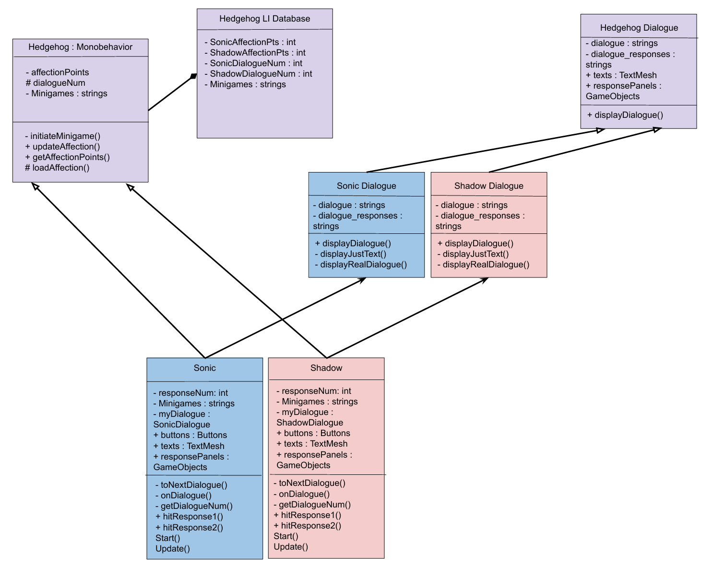
Sonic LI Interactions
Amanda

Slide 29


Process 5: Overworld (World Design)
My feature: World Design
As the player navigates through the game world, they will interact with characters.
The game world (library) is made up of many rooms, each with a different appearance and functionality.
When interacted with, the characters will interact with the player depending on score, lockout status, and other factors retrieved in world data.
Depending on the character’s reaction, the game will enter dialogue, minigames, or remain in the overworld if the character rejects the player’s interaction.
Priority: 2
Complexity: 2
Penguine
Carson Gustavel

Slide 30
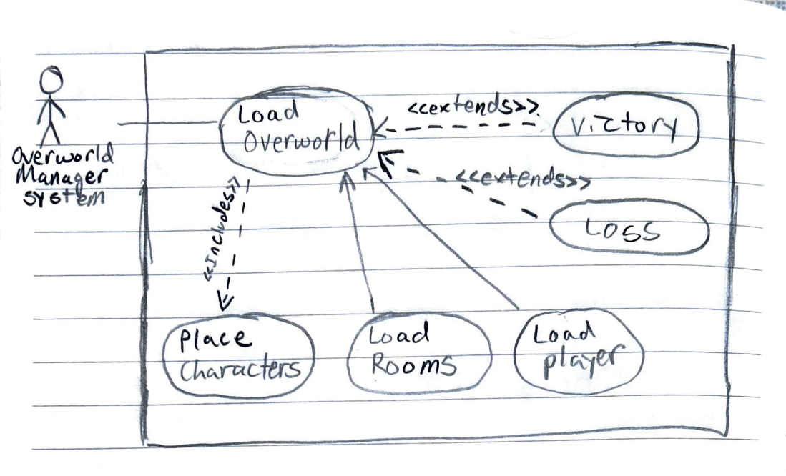
Process 5: Overworld
Use Case 1:​ Load Overworld
The game enters the overworld
Exeception: Lose and win conditions are checked. If triggered, victory or loss screens are displayed.
All rooms are loaded.
Retrieve locations of the player and the last interacted character. Player and character are placed in these rooms.
The rest of the characters are loaded in random locations.
Carson Gustavel

Slide 31
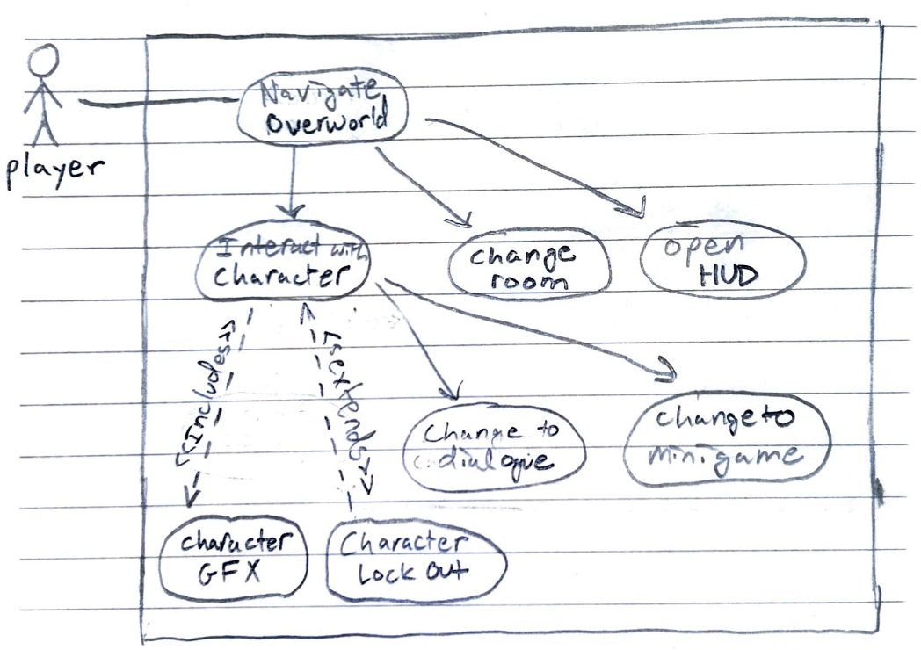
Process 5: Overworld
Use Case 2:​
The player navigates the library to try and find a character to interact with.
The player navigates through several rooms.
The player attempts to interact with a character.
Exception: If the character is locked out, the character will reject the dialogue. The player will remain in the overworld.
Otherwise, the player goes on a date with the character (dialogue, minigame)
Carson Gustavel

Slide 32
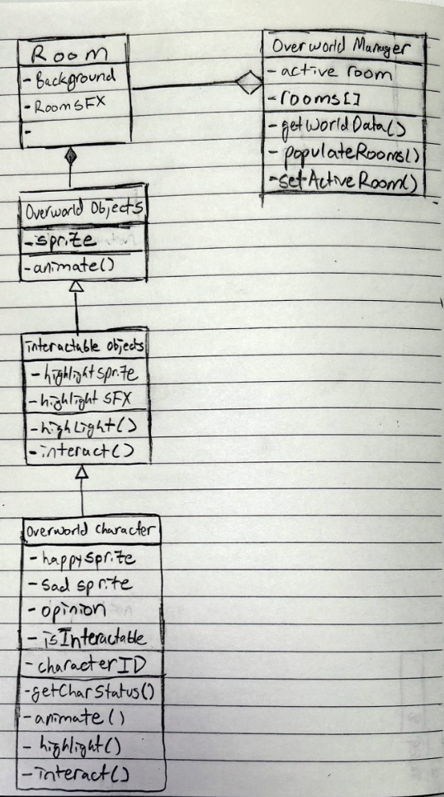
Process 5: Class diagram
Superclass: OverworldObject
Subclass: InteractableObject
Subclass: OverworldCharacter
Composition/Aggregation
Penguine
Carson Gustavel

Slide 33

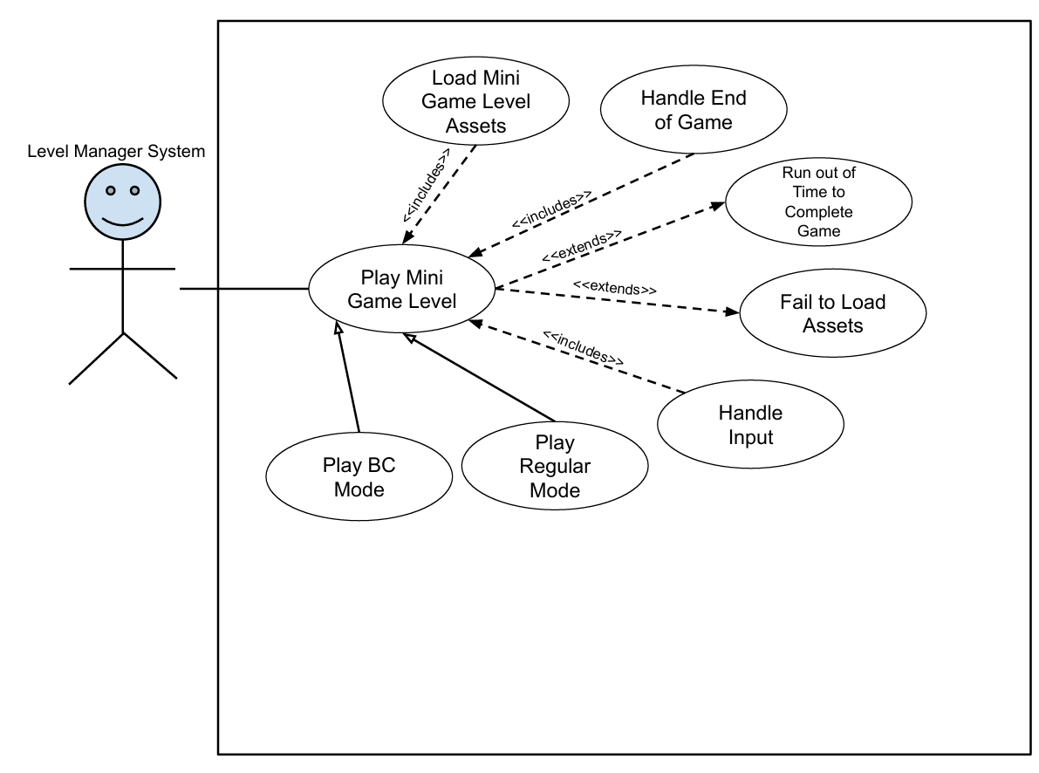
Process 6: Mini Games
Complexity: 3
Priority: 2
Process 6: Use Case
Lance
Lance

Slide 34
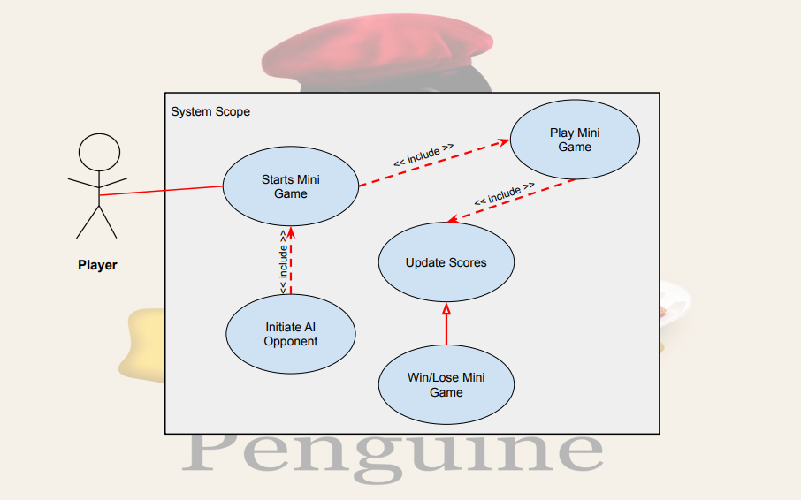
Process 6: Continued
AI Use Case:
Complexity: 3
Priority: 2
Amanda

Slide 35

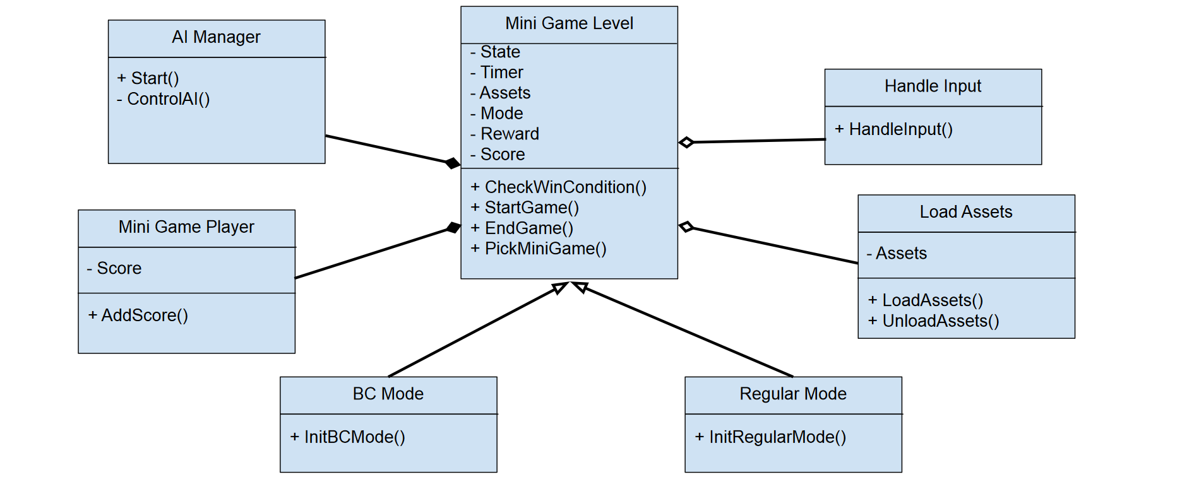
Process 6: Mini Games
Process 6: Class diagram
Lance
Lance

Slide 36
Process 7: Audio (Owen McDaniel)
My Feature:
Sound Management
Background Music
Dialogue Sounds
Menu and Button Sounds
Mini Game Audio
Scoring System
Priority: 3
Audio isn't necessary for the game to function, but it does make the game more responsive and polished.
Complexity: 2
Audio and Scoring shouldn't be too complicated besides the interaction with the databases

Slide 37
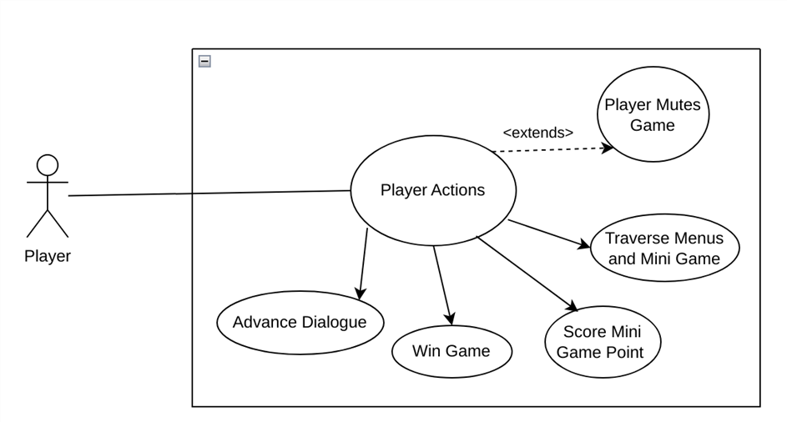
Process 7: Audio Case Diagram
Owen

Slide 38
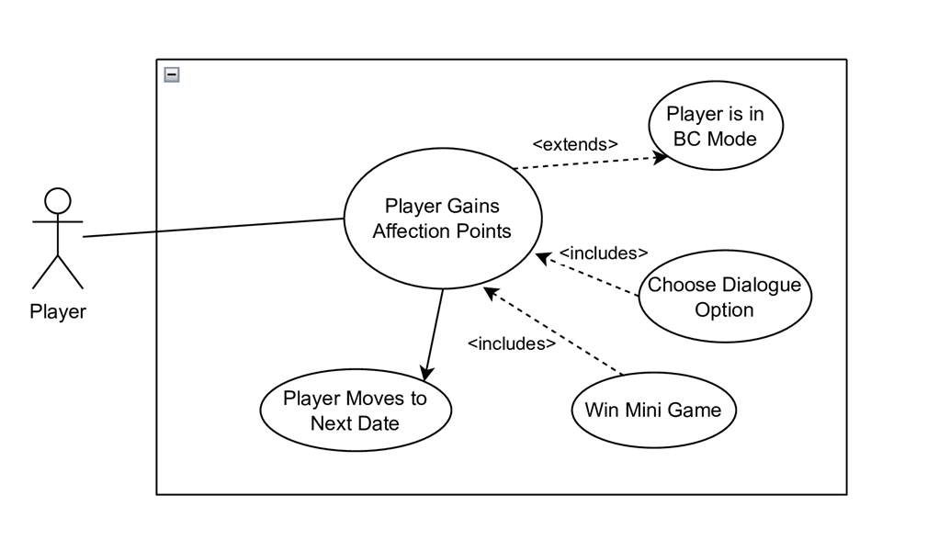
Process 7: Scoring Case Diagram
Owen

Slide 39
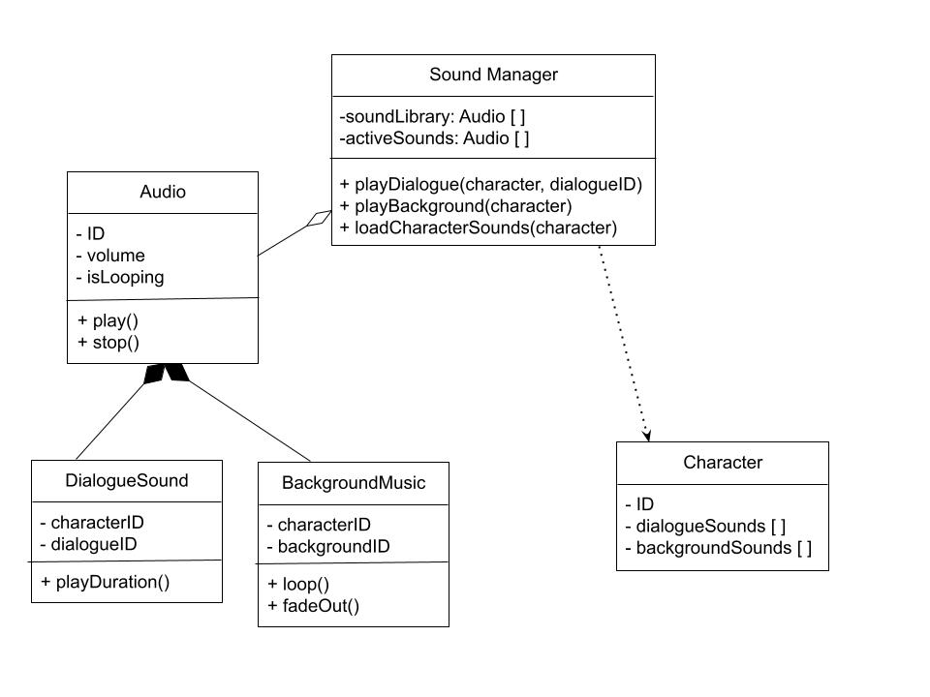
Process 7: Audio Class Diagram
Owen

Slide 40
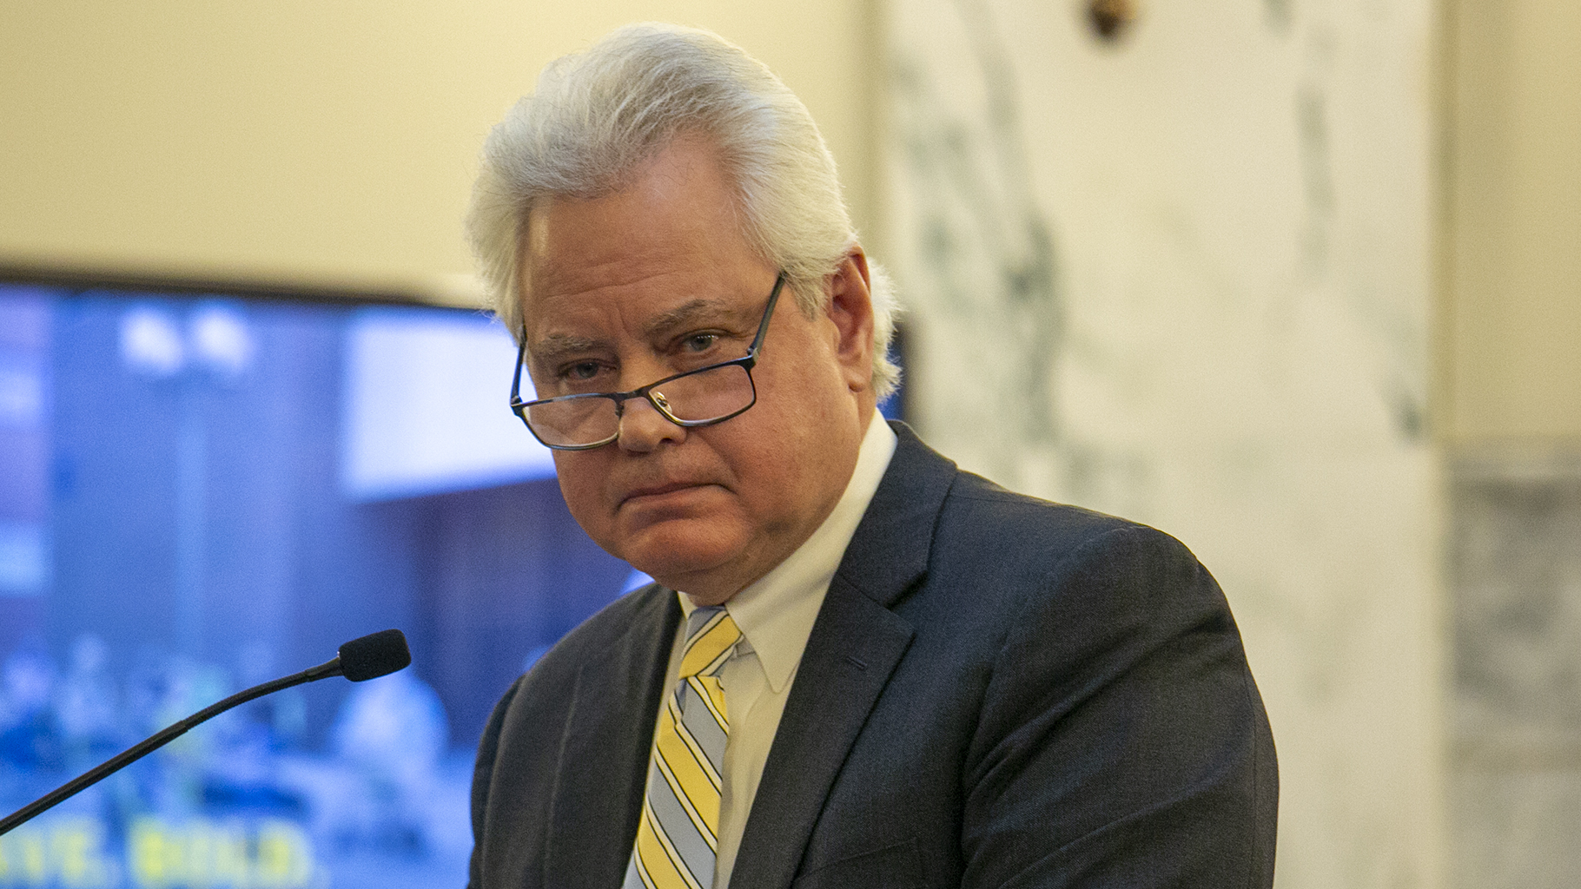
Any Questions?

